Slide 1
Technical Vocational Education and Training in Cabo Delgado
www.norway.info

Slide 2
Background
130 TCF gas + possibly 150 Tcf of additional undiscovered gas resources offshore Cabo Delgado and Inhambane. Additional resources will be discovered, as exploration increases.
Enough gas to satisfy 10 LNG trains and other mega-projects.
Anadarko and ENI are likely to start construction of a Liquefied Natural Gas (LNG) plant in Cabo Delgado in 2014/15, which implies a need for skilled workers. Construction is planned for two LNG trains initially, but possibly expanding up till 10-12 trains in the subsequent years.
The current lack of skilled labor is regarded as one of the greatest challenges for local employment.
Only exists general statements in the Gas consessions on local contribution, no formal requirements on local content.
Legislation is being prepared.

Slide 3
Embassy Consultancy
Consultancy project was initiated by the Norwegian Embassy, in cooperation with MINED, INP, PIREP
Will deliver report to MINED to be used to improve schools in Cabo Delgado and to enhance local content
External requirements and financing needed
Focus on the needs in the construction and service industries

Slide 4
The idea being…
Carrot rather than stick:
Gas companies will benefit from qualified local labour
Local communities at ease with being involved
Not much core compentence in the Gas companies, go for the surrounding activities (next slide)

Slide 5
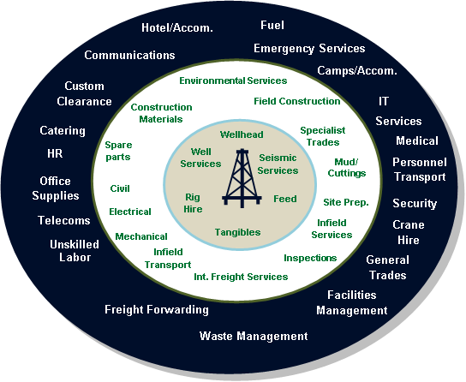
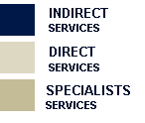
Business and Employment opportunities (direct and indirect services)

Slide 6
PPP development of existing facilities (Macomia and Pemba)
Public Private Partnership: common goals and long term perspective
Use of local school infrastructure
A whole specter from short courses to several years of specialised training
Involving MINED,MINTRAB, MIREM, INP, INEFP, PIREP for optimum coordination
The Gas companies to have an active role

Slide 7
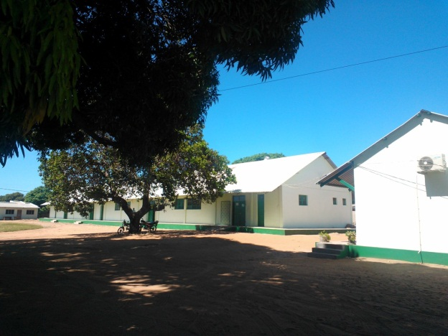
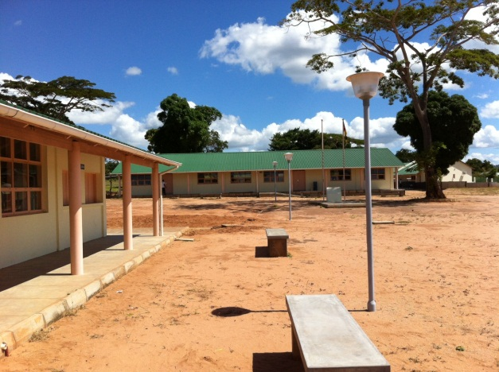
Proposed investments
Assumptions:
Pemba institute: 4 classes times 3, 20 students each class: 240 students
INEFP, Pemba: 1000 students on short or medium term courses
Macomia school
4 classes, 240 students
2 training workshop buildings with equipment,
dormitory for 100 people, 6 teacher houses, new water supply and internal piping
Recruitment and training of teachers
Qualification descriptions

Slide 8
Conclusions
~ 4 million dollars would give close to 500 technicians and 1000 trained workers every year in 5 years. Good value for money by using existing facilities as the base
The industry will have to pay most of the project expenditures, but will get much of the local, trained manpower they need for the construction phase of LNG
Local content will go beyond the construction activities, and benefit the whole society

Slide 9
Project organization and financing
PIREP is a success. Owned by the two ministries who are involved in this project (MINTRAB, MINED).
PIREP should own the project, assisted by outside technical experts
ENI and Anardarko to pay most of the investments
Donor funding to enhance development aspects and integrety
Government to take part og the operating costs

Slide 10
Obrigado!

